Slide 1
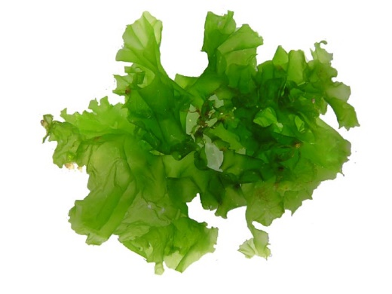
Bioremediation of Strontium and Copper in water by Algae and Sea Urchins
Group: 1-34
protistaproject.weebly.com
Sun Yudong 4S120 Dominique Huynh AOS
Zheng Yu Bo 4S127 Sabrina Kim AOS

Slide 2
Content
Introduction
Rationale & Objectives
Materials and Methods
Materials and Apparatus
Methodology
Variables
Results and Discussions

Slide 3
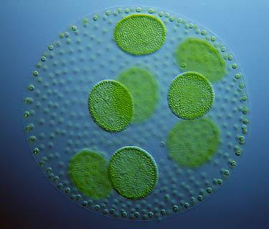
Introduction
Algae are a large group of photoautotrophic organisms
They can survive in various kinds of conditions and are extremely easy to grow.
(“Large-Scale Production of Biofuels Made From Algae Poses Sustainability Concerns; Further Innovations Needed to Reach Full Potential,” 2012)
Hence, algae are a very accessible resource, and can be readily used for bioremediation.
www.microscopy-uk.org.uk

Slide 4
Introduction
Heavy metal pollution
Rapid Industrialization
Aquatic Environment
Quickly Absorbed
Extremely Toxic to aquatic animals
(Bishnoi, Anju, & Garima, 2004)
Notes:
Heavy metal pollution is a serious problem that the world is facing today, with rapid industrialization
A remarkable increase in the use of heavy metals over the past few decades has inevitably resulted in an increased flux of metallic substances in the aquatic environment (Bishnoi, Anju, & Garima, 2004)
This poses a serious threat to the aquatic organisms’ health as heavy metals are highly toxic, and is quickly absorbed into the bodies of the organisms

Slide 5
Biosorption
Physical adsorption
The process where the heavy metals are adsorbed into algae
Cell wall of green algae contains heteropolysaccharides, which offer carboxyl and sulfate groups for sequestration of heavy metal ions (Kumar & Oommen, 2010)
Absorption
Mayaca fluviatilis Algae takes in heavy metal ions and absorbs it
Heavy metals such as Cu are essential micronutrients for algal metabolism (Bunghez, Ion, Dumitriu, & Fierascu, 2010)
Notes:
In the process of physical adsorption, heavy metal ions accumulated on the cell wall of the algae, which contains heteropolysaccharides that offer carboxyl and sulfate groups to accommodate these heavy metal ions.
However, since heavy metals such as copper are essential micronutrients and the Mayaca Algae has been found to take in heavy metal ions and absorb it, we believe a process of absorption also exist in the process of bioremediation of these heavy metal ions

Slide 6
Rationale
Spirogyra sp. has been known to have the ability to accumulate heavy metals such as Cadmium and Mercury (Kumar & Oommen, 2010)
We believe that the same can be achieved with marine green algae under the division Chlorophyta
Research has shown that marine algae Tetraselmis is able to remove Cadmium (Pérez-Rama, Abalde Alonso, Herrero López, & Torres Vaamonde, 2002)
We speculate that another marine algae Ulva will also be able to remove heavy metal ions
For this project, we will be investigating the effectiveness and efficiency of Ulva in absorbing heavy metal ions.
Notes:
Since the Mayaca Algae has been known to be able to bioremediate heavy metal ions, we believe that the same can be achieved with green algae, Chlorophyta.
Also, research has shown that 2 divisions of chlorophyta has demonstrated bioremediation properties. The marine algae Spirogyra Sp. is able to remove mercury and cadmium from water, while Tetraselmis is able to remove cadmium. We speculate that the same can be achieved with Ulva. Hence, we will be testing the effectiveness and efficiency of Ulva in bioremediating heavy metal ions.

Slide 7
Rationale
For this project, we will be working on:
Cu²⁺
Sr²⁺

Slide 8
Rationale
Cu²⁺ finds its way to water bodies through wastewater from Cu wire mills, coal burning industries, electroplating, tanning, smelting and refining, insecticides, fungicides, and iron and steel producing industries. (Bishnoi, Anju, & Garima, 2004)
Cu²⁺ is also a major component of anti-fouling paint on ship hulls
Unfortunately, many methods used to safely dispose of Cu²⁺ require high capital and recurring expenditures
Acceptable human threshold: 1.3 ppm (US EPA, n.d.)
Ocean: 0.00025 ppm in water and up to 100 ppm in sediments (Neal Blossom, n.d.)
Cu²⁺
Notes:
Many method are expensive ->non-optimal

Slide 9
Rationale
Strontium is released after a nuclear disaster
The concentrations found were up to 85 Bq·m⁻³ for ⁹⁰Sr and 265 Bq·m⁻³ for ⁸⁹Sr after Fukushima Daiichi incident (Casacuberta et al., 2013)
Sr²⁺ has similar electronic configuration as Ca²⁺ found in spines of sea urchins
AOS will be exploring the bioremediation of heavy metal ions using sea urchins
Absorbed into spines of sea urchins
Displaces Ca²⁺ in spines of sea urchins
Notes:
As for strontium, it is a common form of pollutant that is released after a nuclear disaster. In fact, after the Fukishima Daiichi incident, the concentration of radioactive isotopes of Strontium were up to 960 ppm and 265 Becquerel per meter cubed.
And since Strontium has a similar electronic configuration as the Calcium that is found in the spines of the sea urchins, we believe that Strontium will be taken up by these sea urchins spines.
However, experimentation with sea urchins will be explored by AOS, and we shall not elaborate further.

Slide 10
Objectives
A study of the effect of biosorption of heavy metals ions using live and dead algae will be conducted.
A comparison between dead and live algae
The quantitative measurement of biosorption will be done through biosorption capacity and biosorption efficiency

Slide 11
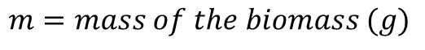
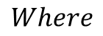
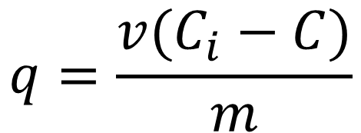
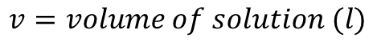
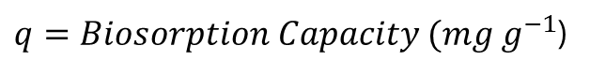
Biosorption Capacity
$$q=\frac{v(C_{i}−C)}{m}$$
$$Where$$
$q=Biosorption Capacity (mg g^{−1}$)
$$v=volume of solution (l)$$
$$C_{i}=Initial Concentration of the solution (mg l^{−1})$$
$$C=Final Concentration of the solution (mg l^{−1})$$
$$m=mass of the biomass (g)$$
(Fu et al, 2012)

Slide 12
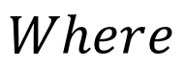
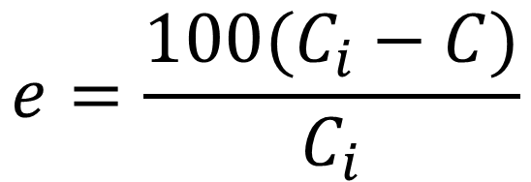
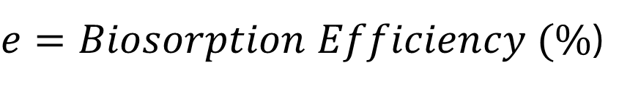
Biosorption Efficiency
$$e=\frac{100(C_{i}−C)}{C_{i}}$$
$$Where$$
$e=Biosorption Efficiency (\%$)
$$C_{i}=Initial Concentration of the solution (mg l^{−1})$$
$$C=Final Concentration of the solution (mg l^{−1})$$
(Fu et al, 2012)

Slide 13
Hypothesis
Live algae are better heavy metal bioremediators than dead algae

Slide 14
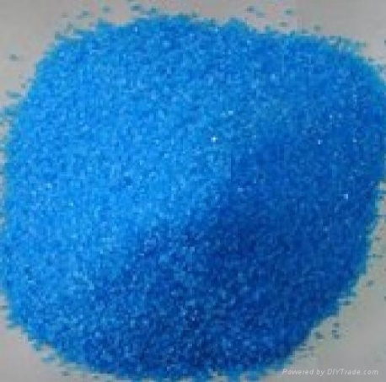
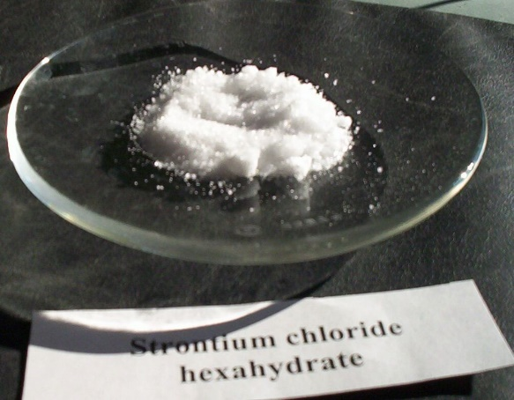
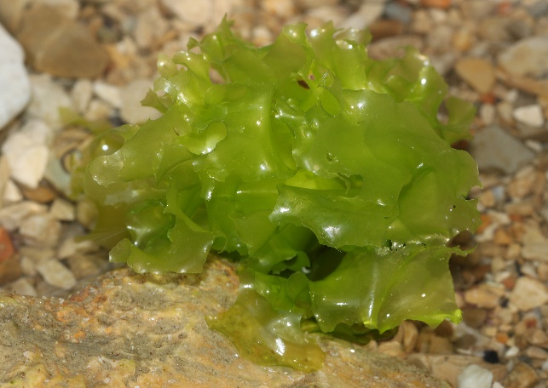
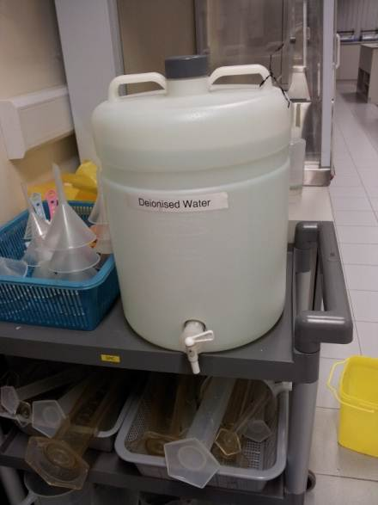
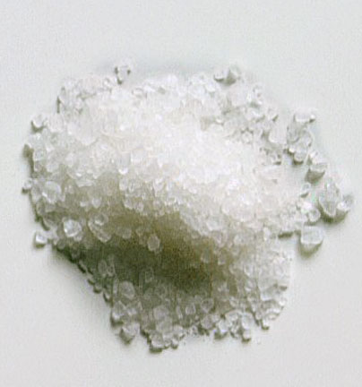
Materials
Copper(II) Sulfate pentahydrate
Strontium chloride hexahydrate
Ulva
Deionized water
Instant Ocean/ Sea Salt
de.wikipedia.org
img.diytrade.com
en.wikipedia.org
www.topnews.in

Slide 15
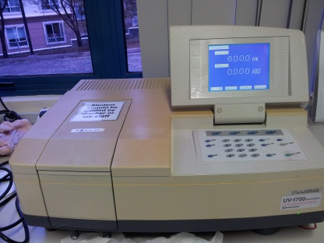
Apparatus
Spectrophotometer
Tanks
Pumps
Lights
Colorimeter
See-saw rocker
Air Conditioner
Conical flask
Orbital shaker
Centrifuge
Oven

Slide 16
Methodology [Main Experimental Timeline]
Using Live algae
Using Dead & Harvested algae

Slide 17
Overview of Experimental Design
Live Algae → Biosorption at different concentrations of HMI solutions
Dried Algal Tissue → Biosorption at different concentrations of HMI solutions
Compare the results of the quantitative measurement of biosorption using the formulae for biosorption capacity and biosorption efficiency

Slide 18
Methodology [Using Live Algae]
Beyond 25 ppm, sea urchin spines will start to drop and they die (Bielmyer, Brix, Capo, & Grosell, 2005)
Copper (Cu²⁺)
Minimum: DI Water
Upper Threshold: 25 ppm
Human Threshold: 1.3 ppm
Strontium (Sr²⁺)
Minimum: DI Water
Upper Threshold: 960 ppm
Human Threshold: 13.74 ppm

Slide 19
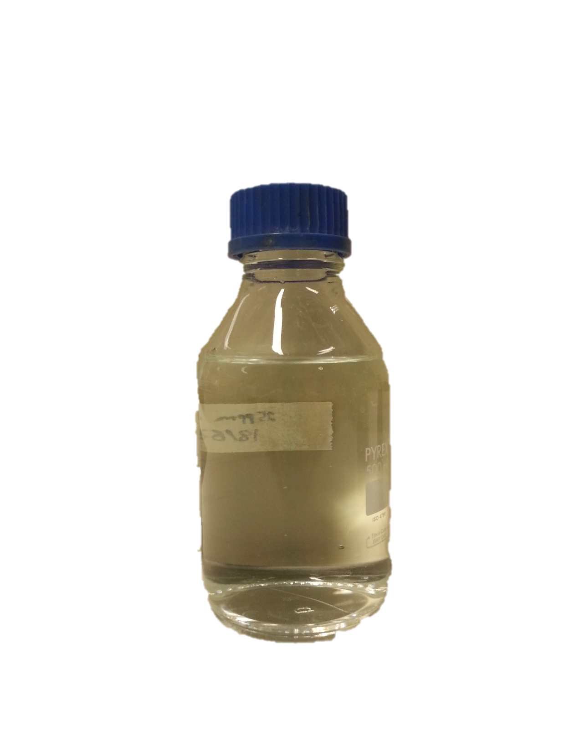
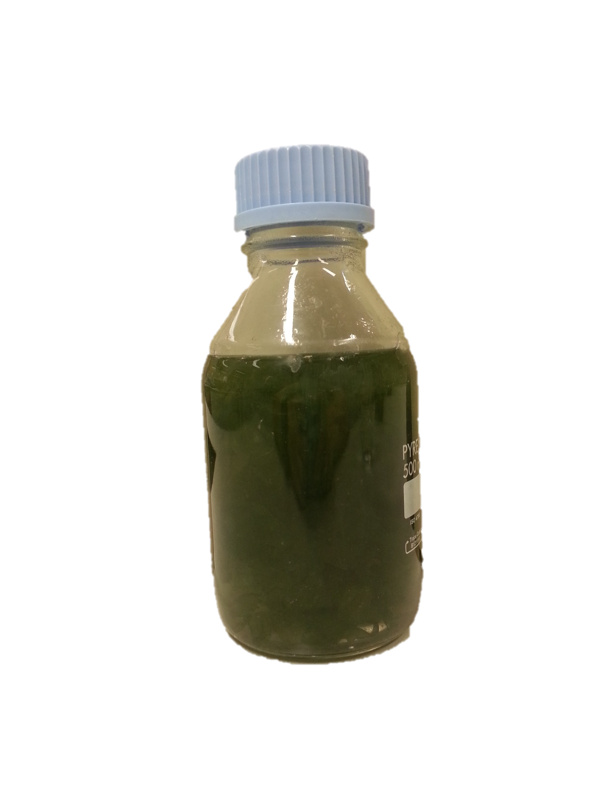
Methodology [Using Live Algae] Copper
Cu²⁺
Control:
DI Water + CuSO₄
Test:
DI Water + CuSO₄ + 5g Algae
× 5 Replicates
Samples were left on orbital shaker at 120 rpm

Slide 20
Methodology [Using Live Algae] Strontium
Sr²⁺
Control:
DI Water + SrCl₂
Test:
DI Water + SrCl₂ + 5g Algae
× 5 Replicates
Samples were left on orbital shaker at 120 rpm

Slide 21
Methodology [Using Live Algae]
Colorimeter will be used to test amount of Cu²⁺ in solution
Spectrophotometer will be used to test amount of Sr²⁺ in solution with Xylenol Orange at 570 nm after dilution
Comparison:
Initial Cu²⁺/Sr²⁺ ion concentration
Final Cu²⁺/Sr²⁺ ion concentration
Final concentration of Cu²⁺/Sr²⁺ in algae
This was repeated many times, and measurement was taken over a period of 5 days
Biosorption Capacity Biosorption Efficiency

Slide 22
Variables [Using Live Algae]
Independent variable
Initial Concentration of Heavy Metal Ion Solution
Controlled Variable
Mass of live Algae used
Volume of water
Dependent Variable
Concentration of Heavy Metal Ion Solution over time
Temperature of surroundings
Temperature of solution
Amount of light available
Time interval between each measurement
Type of heavy metal ions

Slide 23
Methodology [Using Dead & Harvested Algae]
Dry live algae until no further change in dry mass
Submerge algae in 1% Mass-to-volume ratio in concentrated heavy metal solution for 5 days.
Change in concentration of heavy metal ions are recorded over time
Centrifuge and test supernatant

Slide 24
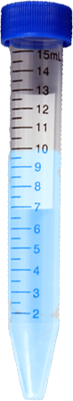
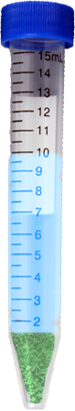
Methodology [Using Dead & Harvested Algae] Copper
Cu²⁺
Control:
DI Water + CuSO₄
Test:
DI Water + CuSO₄ + 0.1g Algae
× 5 Replicates
Samples were left on seesaw rocker at 30 rpm

Slide 25
Methodology [Using Dead & Harvested Algae] Strontium
Sr²⁺
Control:
DI Water + SrCl₂
Test:
DI Water + SrCl₂ + 0.1g Algae
× 5 Replicates
Samples were left on seesaw rocker at 30 rpm

Slide 26
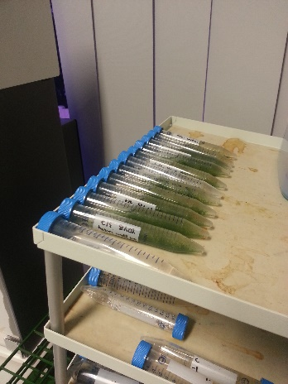
Methodology [Using Dead & Harvested Algae]
Sample will be centrifuged at 9500 RPM for 10 mins
Colorimeter will be used to test amount of Cu²⁺ in solution
Spectrophotometer will be used to test amount of Sr²⁺ in solution
Comparison:
Initial Cu²⁺/Sr²⁺ concentration
Final Cu²⁺/Sr²⁺ concentration
Final concentration of Cu²⁺/Sr²⁺ in dead algae
This was repeated many times
Biosorption Capacity Biosorption Efficiency

Slide 27
Variables [Using Dead & Harvested Algae]
Independent variable
Initial Concentration of Heavy Metal Ion Solution
Type of heavy metal ions
Controlled Variable
Mass of Dead & Harvested Algae used
Volume of water
Temperature of surroundings
Temperature of solution
Time interval between each measurement
Dependent Variable
Concentration of Heavy Metal Ion Solution over time

Slide 28
Methodology [Comparison of living/dead algae]
Results from dead algae tests
Comparison
Results from live algae tests
Through the comparison, we can find out:
The mechanism of removal of heavy metal ions by Algae
Whether live algae or dead algae is a better bioremediator

Slide 29
Results and Discussions

Slide 30
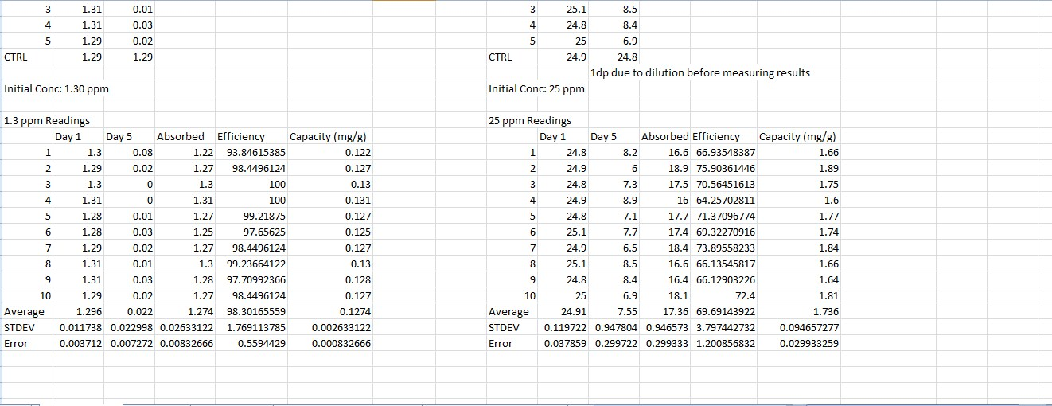
Results
We will take 30 readings for live and dead algae in the different concentrations of Cu²⁺ and Sr²⁺.
The results are compiled into an Excel document
Statistical Tests were then ran
Biosorption Capacity and Biosorption Efficiency are then calculated

Slide 31
Graphs [Cu²⁺ Absorbed]
P > 0.05, Not statistically significant
P < 0.05, Statistically significant
Notes:
Cu²⁺ Absorbed in 1.3 ppm Cu²⁺/ppm
Surface, assimilated into tissue for 25
1.3 ppm has no explanation? More cellulose call wall (because dry mass)
Dry mass increases surface area at low conc is better. But at high conc, the additional mechanism plays a more significant role and uptakes more heavy metal ions

Slide 32
Graphs [Biosorption Efficiency]
Notes:
Biosorption Efficiency for 1.3 ppm Cu²⁺ (%)

Slide 33
Graphs [Biosorption Capacity]
Notes:
Biosorption Capacity for 1.3 ppm Cu²⁺ (mg/g)

Slide 34
Graphs
Notes:
Barely any difference for 1.3, but a greater difference for 25 ppm.

Slide 35
At low concentrations, there is not much of a difference. However, at higher concentrations, live algae is a better bioremediator
Notes:
Barely any difference for 1.3, but a greater difference for 25 ppm.

Slide 36
Statistical Analysis
In order to ensure that the difference in results are statistically significant, a statistical t-test was carried out.
P-value for 1.3ppm:
0.342
P-value for 25ppm:
0.002
Not statistically significant
Statistically significant

Slide 37
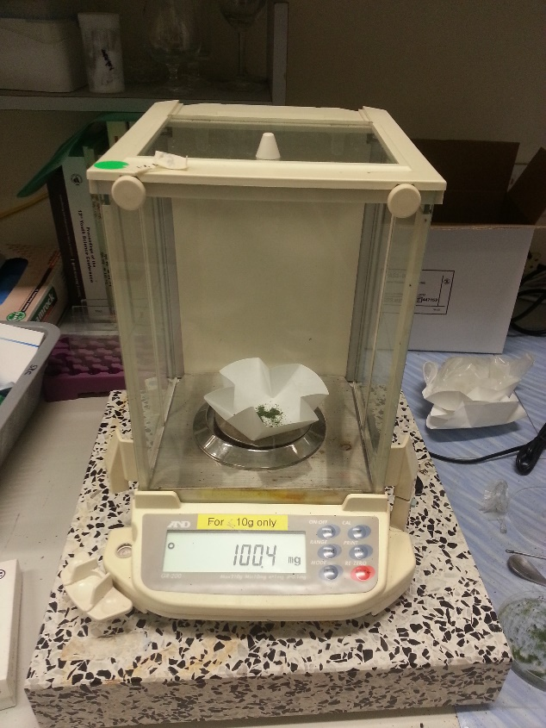
Strontium
The use of xylenol orange resulted in inconsistent readings in both dead and live algae trials
Hence we are still working on strontium measurements

Slide 38
Drawing Conclusions
Our conclusion is that live algae are better bioremediators than dead algae, especially at higher concentrations
This can be seen from the difference in the bioremediation efficiencies of the two types of algae.
Our statistical test further affirms our conclusion by showing that live algae are significantly better bioremediators than dead algae.
Dead has increased surface area for biosorption at low concentration. But at high conc, the additional mechanism plays a more significant role and uptakes more heavy metal ions.

Slide 39
Applications
Through the use of live organisms instead of chemicals, the following can be achieved at low costs and without huge impacts to the habitat:
Remediation in nuclear polluted waters containing Strontium
Remediation of polluted wastewaters due to improper water treatment processes

Slide 40
Applications
For commercial application of algal technology for optimal metal removal from wastewater, the emphasis needs to be on:
Selection of strain with high metal sorption capacity
Adequate understanding of sorption mechanisms
Economic feasibility
By using Sea Urchins with Algae, we are using organisms of the same habitat which are progressive in the food chain, thereby increasing biosorption through bioaccumulation

Slide 41

Future Work
Extend to other species of algae and organisms
Using microalgae to increase overall surface area for absorption
Using other plant materials or crustaceans
Building a bioreactor to remove heavy metal ions from the water at lower cost
horsesforsources.com

Slide 42

Limitations
After drawing out solutions for testing, the amount of solution left in is reduced, thereby increasing algae to solution ratio, which may affect the result
Wet mass (Live) vs. Dry mass (Dead)
rarecrossfit.com

Slide 43
References
Bielmyer, G. K., Brix, K. V., Capo, T. R., & Grosell, M. (2005). The effects of metals on embryo-larval and adult life stages of the sea urchin, Diadema antillarum. Aquatic toxicology (Amsterdam, Netherlands), 74(3), 254–263. doi:10.1016/j.aquatox.2005.05.016
Bioconcentration factors (BCFs) for aquatic organisms. (n.d.). Retrieved from http://uwrl.usu.edu/www/doucette/6730/CEE%205730%20BCF%20lec%209-1.pdf
Bishnoi, N. R., Anju, P., & Garima. (2004). Biosorption of copper from aqueous solution using algal biomass. Journal of Scientific & Industrial Research, 63(October 2004), 813–816.
Bunghez, I.-R., Ion, R.-M., Dumitriu, I., & Fierascu, R.-C. (2010). Heavy Metal Ions Depollution by Marine Natural Products. Journal of Science and Arts, 1(12), 73–78.
Casacuberta, N., Masque, P., Garcia-Orellana, J., Garcia-Tenorio, R., & Buesseler, K. O. (2013). 90Sr and 89Sr in seawater oﬀ Japan as a consequence of the Fukushima Dai-ichi nuclear accident. Biogeosciences, 10, 3649–3659. doi:10.5194/bg-10-3649-2013
Fu, Y. Q., Li, S., Zhu, H. Y., Jiang, R., & Yin, L. F. (2012). Biosorption of copper from aqueous solutions by mycelial pellets of rhizopus oryzae. African Journal of Biotechnology, 11(6), 1403–1411.
Kumar, J. I. N., & Oommen, C. (2010). Removal of heavy metals by biosorption using freshwater alga Spirogyra hyalina. Journal of Environmental Biology, (January 2012), 27 – 31.
Large-Scale Production of Biofuels Made From Algae Poses Sustainability Concerns; Further Innovations Needed to Reach Full Potential. (2012, October 24). National-Academies.org | Newsroom. Retrieved November 9, 2013, from http://www8.nationalacademies.org/onpinews/newsitem.aspx?RecordID=13437
Mehta, S. K., & Gaur, J. P. (2005). Use of algae for removing heavy metal ions from wastewater: progress and prospects. Critical reviews in biotechnology, 25(3), 113–152. doi:10.1080/07388550500248571
Neal Blossom. (n.d.). Copper in the Ocean Environment.
Pérez-Rama, M., Abalde Alonso, J., Herrero López, C., & Torres Vaamonde, E. (2002). Cadmium removal by living cells of the marine microalga Tetraselmis suecica. Bioresource Technology, 84(3), 265–270. doi:10.1016/S0960-8524(02)00045-7
Suresh, B., & Ravishankar, G. A. (2004). Phytoremediation--a novel and promising approach for environmental clean-up. Critical reviews in biotechnology, 24(2-3), 97–124. doi:10.1080/07388550490493627
US EPA, O. (n.d.). Basic Information about Copper in Drinking Water. Retrieved November 15, 2013, from http://water.epa.gov/drink/contaminants/basicinformation/copper.cfm

Slide 44


Any Questions?
fbcdn-dragon-a.akamaihd.net

Slide 45
Image References
Cover Photo: Ulva http://protistaproject.weebly.com/uploads/1/2/2/7/12279313/516921448_orig.jpg
http://www.horsesforsources.com/wp-content/uploads/2011/05/The-present-of-work.jpg
http://rarecrossfit.com/wp-content/uploads/2013/07/limitations.jpg

Slide 46
Graphs [Day 5 Readings]

Slide 47
Graphs
Here are the graph comparisons for live and dead algae in 1.3 ppm Cu²⁺ solution

Slide 48
Graphs
Here are the graph comparisons for live and dead algae in 1.3 ppm Cu²⁺ solution

Slide 49
Graphs
Here are the graph comparisons for live and dead algae in 25 ppm Cu²⁺ solution

Slide 50
Graphs
Here are the graph comparisons for live and dead algae in 25 ppm Cu²⁺ solution

